Slide 1
Combining Graph-Iterative and Streaming Computations for Influence Graph Derivations
Bastian Meyer

Slide 2
Introduction

Slide 3
Social Networks
Social networks are omnipresent
Facebook: 2.01 billion monthly active users (June, 2017)
Twitter: 328 million monthly active users
Problem: filter bubbles
(Mostly) isolated groups of users perceiving only their own viewpoints
Simplifies spread of fake news
Threat to society
Understand how filter bubbles form and function
Are there patterns in the connections between users?
What and who influences a user to share some content?
Notes:
Facebook: quarter of the world population uses it at least once a month
Twitter: one of the most influential networks
Social networks:
Connect to people all around the world
Subscribe to interesting content
Post and reshare any content

Slide 4
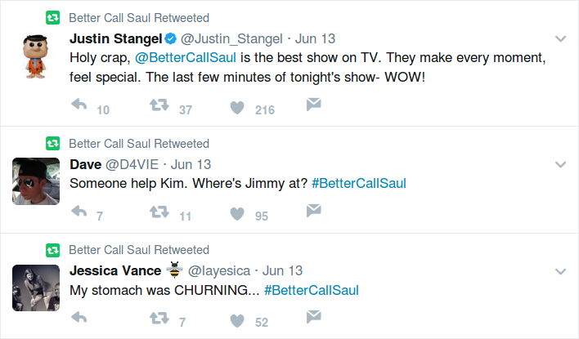
Twitter
Tweets: short, (usually) public messages of up to 140 characters
Unidirectional relations: Alice can follow Bob, but Bob does not have to follow her
Alice is Bob’s follower
Bob is Alice’s friend
Retweets:
Repost of a Tweet
Or another Retweet

Slide 5
Retweet Cascades
All Retweets of some Tweet
Measure of influence in social networks: more influential users are more likely to be retweeted
Problem:
Intermediary Retweets are not preserved
All Retweets only reference the original Tweet
Alice
Alice tweets
Carol retweets Alice at 2:04pm
Bob retweets Alice at 4:02pm
Dave retweets Alice at 5:01pm
Alice tweets
Carol retweets Alice at 2:04pm
Bob retweets Carol at 4:02pm
Dave retweets Carol at 5:01pm
Carol
Bob
Dave

Slide 6
Reconstructing Influences
Alice
Bob
Alice
Alice
Retweets at 2:04 pm
Influenced at 2:04 pm
Carol
Dave
Carol
Carol
Influenced at 4:02 pm
Retweets at 4:02 pm
Retweets at 5:01 pm
Influenced at 5:01 pm
Influenced at 4:02 pm
Bob
Dave
Bob
Dave
Notes:
Assume given social graph
And Retweet cascade from previous slide
Explain why influences are reconstructed this way (social graph, times)
→ Influence graph

Slide 7
Reconstruction Systems
Process a stream of Retweets, compute the influences
Algorithms: rather simple
Complexity:
Real-time processing:
5,700 Tweets per second on average
143,199 Tweets per second peak
Amount of data: 1 TB for the social graph
Social graph must be kept in main memory
Too large for single computer → distribution
Recon- struction
Stream of Retweets
Retweets
Influence Edges
Notes:
Rather simple algorithms → reconstructed by hand on previous slide

Slide 8
Previous Work
Ongoing research topic at the Research Group on Web Science
Reconstruction system built on Apache Storm
Framework for distributed stream processing
Current state: reconstruct a data set with 3.6 million Retweets in less than 20 seconds
Notes:
Not going to explain the existing system

Slide 9
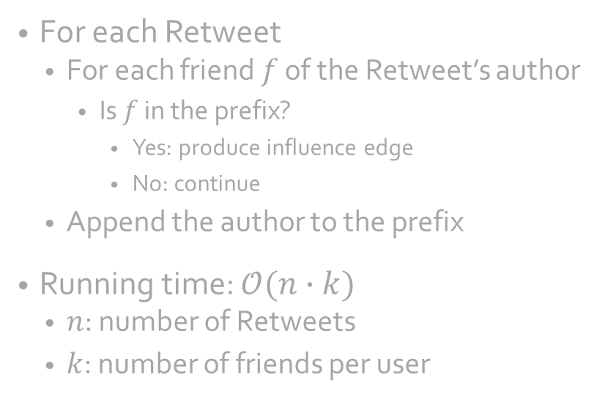
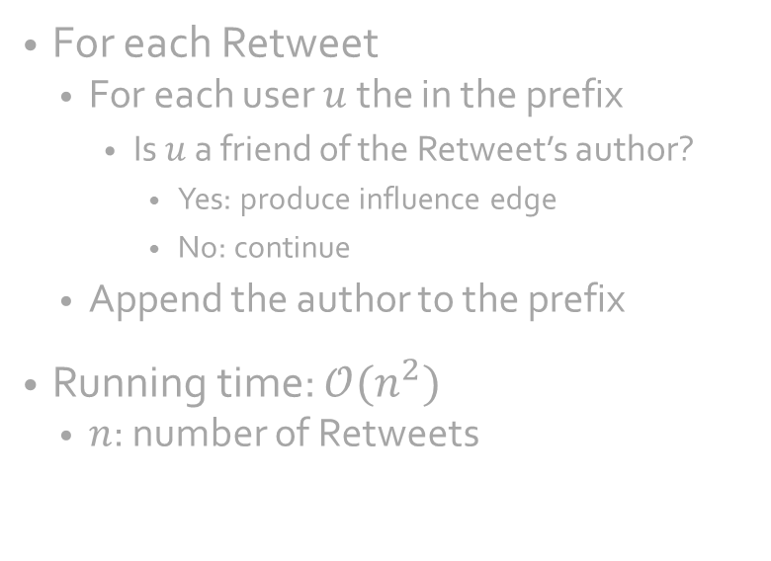
Reconstruction Algorithms
Prefix: list of authors of all a cascade’s Retweets and the original Tweet
Prefix Iteration
User Iteration
For each Retweet
For each user $u$ the in the prefix
Is $u$ a friend of the Retweet’s author?
Yes: produce influence edge
No: continue
Append the author to the prefix
Running time: $𝒪(n^{2})$
$n$: number of Retweets
For each Retweet
For each friend $f$ of the Retweet’s author
Is $f$ in the prefix?
Yes: produce influence edge
No: continue
Append the author to the prefix
Running time: $𝒪(n∙k)$
$n$: number of Retweets
$k$: number of friends per user
Notes:
First: term “prefix” – initially only original Tweet’s author, extended with each Retweet
User Iteration better than Prefix Iteration if more Retweets than friends
On average, 208 friends per user

Slide 10
Goal
Implement a different reconstruction system
To evaluate the existing one
Using a data-parallel framework supporting incremental input updates and iterative stream processing
Assumptions
Static social graph
Retweets are ordered chronologically on their time of creation
Notes:
Data sets as CSV and JSON files

Slide 11
Differential Dataflow

Slide 12
Differential Dataflow
Data-parallel computational model introduced by Microsoft Research in 2012
Incremental input updates
Iterative stream processing
Two implementations
Naiad (C#)—discontinued
Timely Dataflow & Differential Dataflow (Rust)
Notes:
Unique combination of features

Slide 13
Rust
“When we first started working on Rust as a research project in 2009, we (…) were particularly interested in two things: how to build more ambitious parallel architectures, and how to implement high-performance software without many of the pitfalls and vulnerabilities of C++.”
— Dave Hermann, Director of Strategy at Mozilla Research
Notes:
Systems programming language by Mozilla Research
Aims at memory safety without penalizing performance
Strong type system statically guarantees:
No segmentation faults
No buffer overflows
No data races in concurrent programs

Slide 14
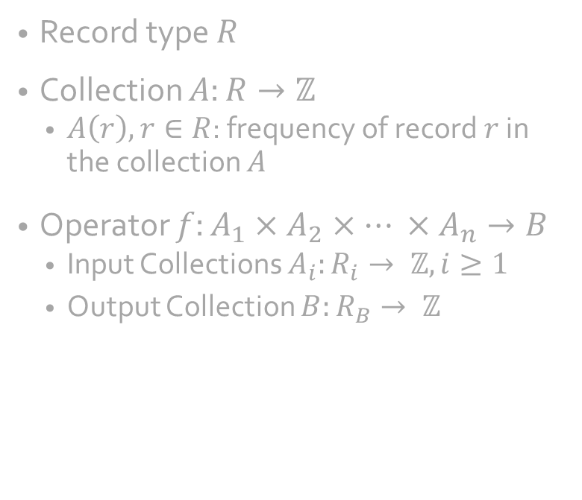
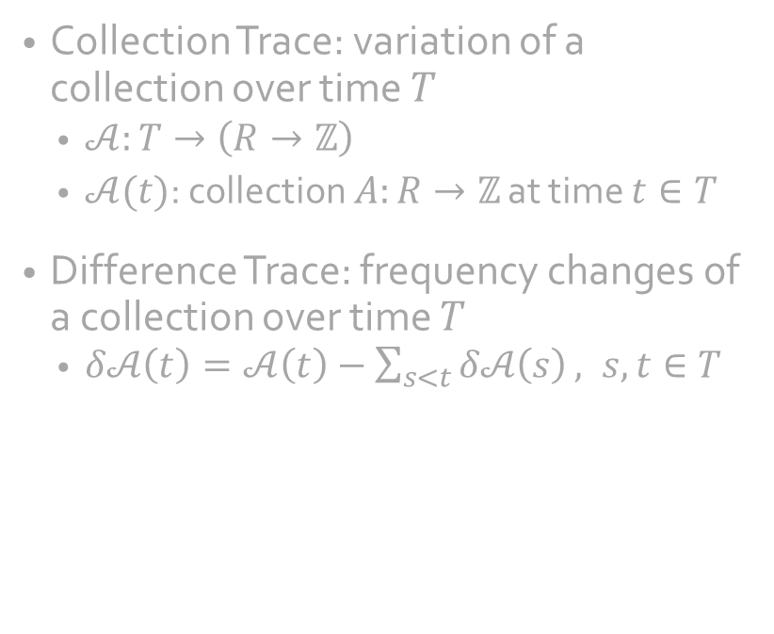
Definitions
Record type $R$
Collection $A:R→ℤ$
$A\left(r\right), r∈R$: frequency of record $r$ in the collection $A$
Operator $f:A_{1}×A_{2}×… ×A_{n}→B$
Input Collections $A_{i}:R_{i}→ ℤ, i≥1$
Output Collection $B:R_{B}→ ℤ$
Collection Trace: variation of a collection over time $T$
$𝒜:T→\left(R→ℤ\right)$
$𝒜(t)$: collection $A:R→ℤ$ at time $t∈T$
Difference Trace: frequency changes of a collection over time $T$
$δ𝒜\left(t\right)=𝒜\left(t\right)−\sum_{s<t}{δ𝒜\left(s\right)}, s,t∈T$
Notes:
Some record type
Collection: function from record type to integers
Addition and Subtraction can be applied to two collections by applying them to their respective frequencies
Operator: function from collections to another collection

Slide 15
























Stateful Operators
Traditional
Differential
$$∅$$
Distinct
$$∅$$
$$∅$$
Distinct
$$∅$$
$$t=0$$
$$S_{0}$$
$$t=1$$
$$\{A,A,B,C\}$$
Distinct
$$\{A,B,C\}$$
$$\{A:+2,B:+1,C:+1\}$$
Distinct
$$\{A:+1,B:+1,C:+1\}$$
$$S_{1}$$
$$t=2$$
$$\{A,B,C\}$$
Distinct
$$\{A,B,C\}$$
$$\{A:−1\}$$
Distinct
$$∅$$
$$S_{2}$$
$$t=3$$
$$\{B,C\}$$
Distinct
$$\{B,C\}$$
$$\{A:−1\}$$
Distinct
$$\{A:−1\}$$
$$S_{3}$$

Slide 16







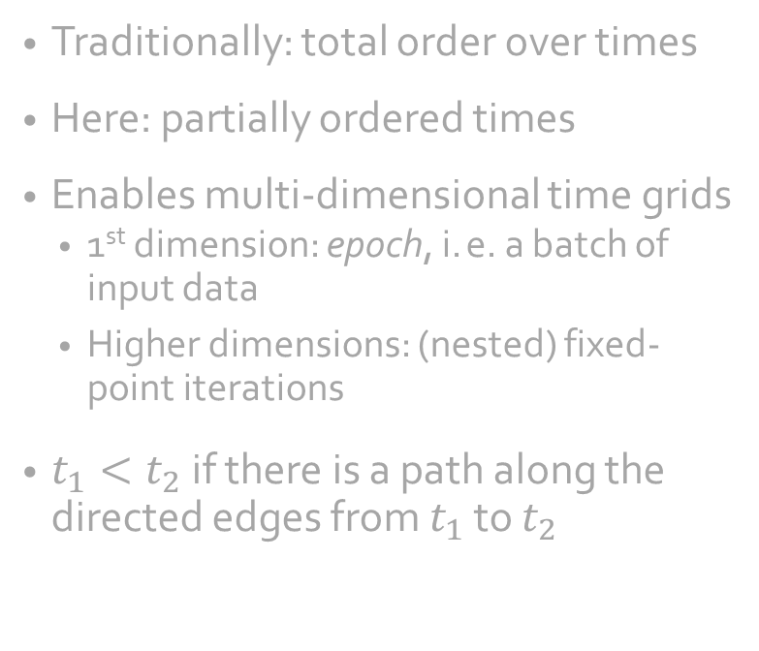











Partially Ordered Times
Traditionally: total order over times
Here: partially ordered times
Enables multi-dimensional time grids
1st dimension: epoch, i. e. a batch of input data
Higher dimensions: (nested) fixed-point iterations
$t_{1}<t_{2}$ if there is a path along the directed edges from $t_{1}$ to $t_{2}$
Fixed-Point Iteration
$$1,1$$
$$1,2$$
$$1,3$$
$$1,4$$
$$…$$
Input Batches
$$2,1$$
$$2,2$$
$$2,3$$
$$2,4$$
$$…$$
$$3,1$$
$$3,2$$
$$3,3$$
$$3,4$$
$$…$$
$$…$$
$$…$$
$$…$$
$$…$$

Slide 17






















Collection Derivation
Recall: collection at time $t$ is the sum of all previous differences
Fixed-Point Iteration
$$+A,+B$$
$$+C$$
$$−C$$
$$−B$$
$$…$$
Input Batches
$$\{A,B\}$$
$$\{A,B,C\}$$
$$\{A,B\}$$
$$\{A\}$$
$$\{A\}$$
$$−B$$
$$+B$$
$$…$$
$$\{A\}$$
$$\{A,C\}$$
$$\{A\}$$
$$\{A\}$$
$$\{A\}$$
$$…$$
$$…$$
$$…$$
$$…$$
$$…$$
Notes:
First batch: straight forward
Second batch:
-B: /
Iteration does not introduce changes, collection changes due to first batch’s iteration
Iteration does not introduce changes, collection changes due to first batch’s iteration
+B: first batch removes B, would result in negative amount of B’s, thus add a B

Slide 18







Distribution
Process $0$
Process $1$
Distribution in two directions:
Number of processes
Number of threads per process: Workers
Workers perform the computation
All workers behave the same way
Data distributed among workers based on some key
Inter-process communication via TCP/IP
Worker
$$0$$
Worker
$$3$$
Worker
$$1$$
Worker
4
Worker
$$2$$
Worker
$$5$$
Notes:
Distribution in two directions:
Each process must have same number of workers
Multiple processes on single computer possible
Data distributed … based on some key: for example, even numbers on worker 0, odd number on worker 1

Slide 19
Batches
Data records have an attached timestamp
Batch: all records with the same timestamp
Later batches can depend on previous batches
Operators exchange progress information to synchronize the computation
The smaller the batches, the more frequent the synchronization
Notes:
Synchronization across multiple workers required

Slide 20
Implementation
CRGP

Slide 21
Conventions
Prefix: associates each user in a cascade with the time of their Tweet or Retweet

Slide 22
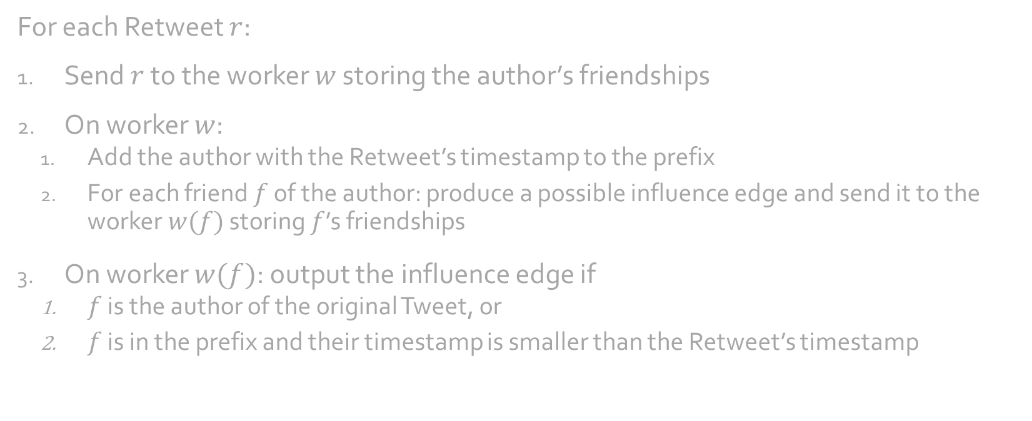
Algorithm: LEAF
For each Retweet $r$:
Send $r$ to the worker $w$ storing the author’s friendships
On worker $w$:
Add the author with the Retweet’s timestamp to the prefix
For each friend $f$ of the author: produce a possible influence edge and send it to the worker $w(f)$ storing $f$’s friendships
On worker $w(f)$: output the influence edge if
$f$ is the author of the original Tweet, or
$f$ is in the prefix and their timestamp is smaller than the Retweet’s timestamp
Notes:
Author of original Tweet must be in the prefix on the worker storing their friendships
But first possibility to add it there is when another Retweet is processed there
All other Retweets before that Retweet will miss the original author as an influencer
Thus, include the author in the possible influence edge
Two hops across the workers

Slide 23
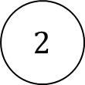
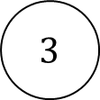


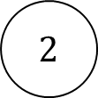
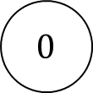
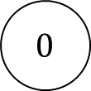

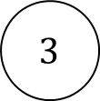
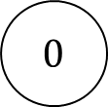
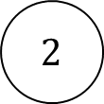
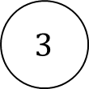
Algorithm: LEAF
Retweets
$$0$$
$$0$$
$$0$$
$$1$$
$$1$$
$$1$$
Influence Edges
$$2$$
$$2$$
$$2$$
$$3$$
$$3$$
$$3$$
Influence Edges
Retweet
Possible Influence
Edges

Slide 24
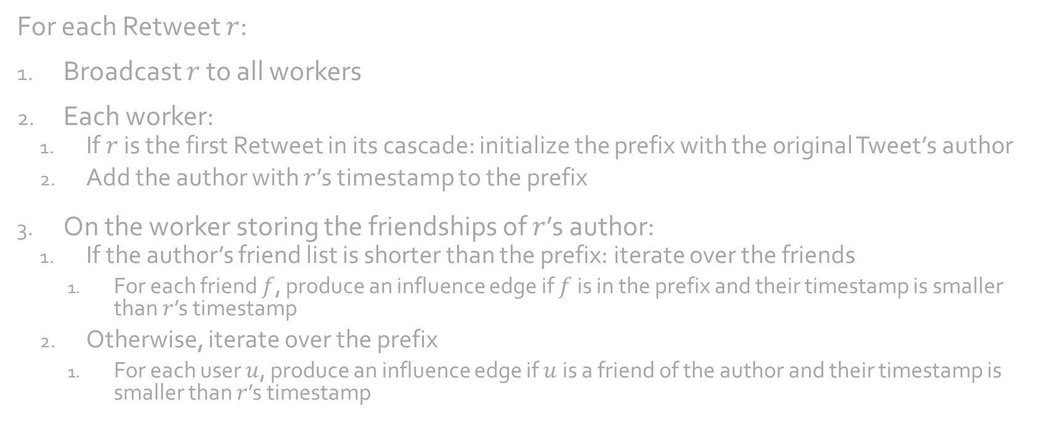
Algorithm: GALE
For each Retweet $r$:
Broadcast $r$ to all workers
Each worker:
If $r$ is the first Retweet in its cascade: initialize the prefix with the original Tweet’s author
Add the author with $r$’s timestamp to the prefix
On the worker storing the friendships of $r$’s author:
If the author’s friend list is shorter than the prefix: iterate over the friends
For each friend $f$, produce an influence edge if $f$ is in the prefix and their timestamp is smaller than $r$’s timestamp
Otherwise, iterate over the prefix
For each user $u$, produce an influence edge if $u$ is a friend of the author and their timestamp is smaller than $r$’s timestamp

Slide 25
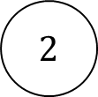


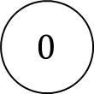
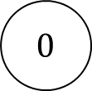
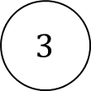
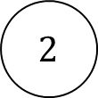
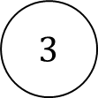
Algorithm: GALE
Retweets
$$0$$
$$0$$
$$1$$
$$1$$
$$2$$
$$2$$
Influence Edges
$$3$$
$$3$$
Retweet

Slide 26
Results

Slide 27
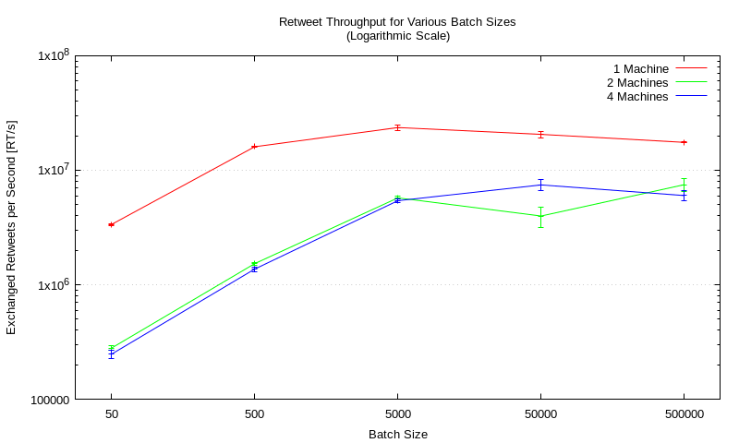
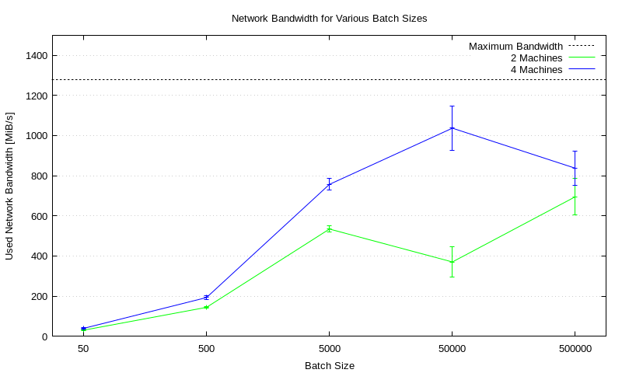
Message Exchange Rate
Retweet Throughput
Network Utilization
Notes:
Goal:
how fast is Timely Dataflow in exchanging messages?
Setup: 4 workers in total, on 1, 2, and 4 machines
10GBit/s network

Slide 28
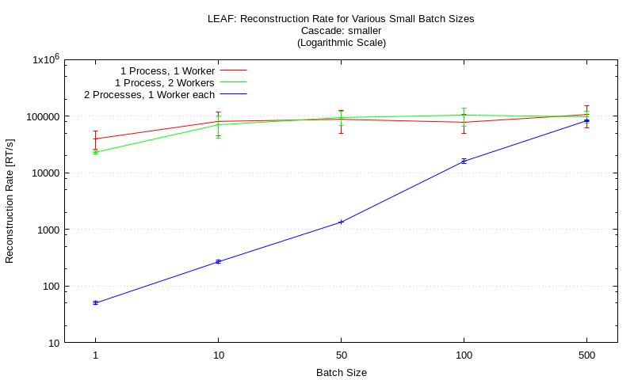
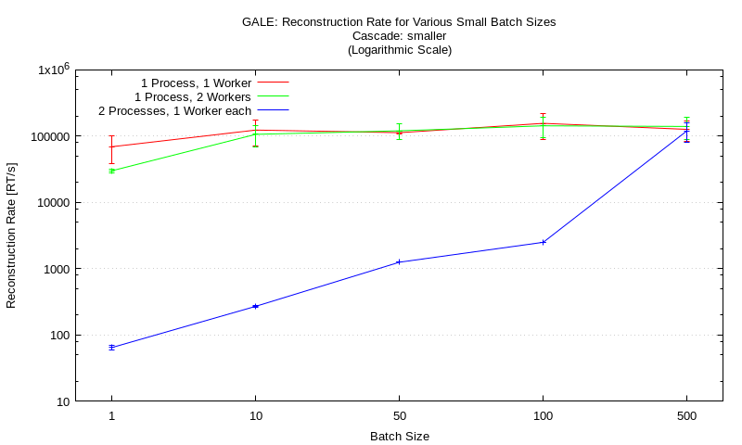
Small Batches
LEAF
GALE
Notes:
Why not use timestamps of Retweets in the computation?
Would result in small batches: in data set with 3.6 million RTs,

Slide 29
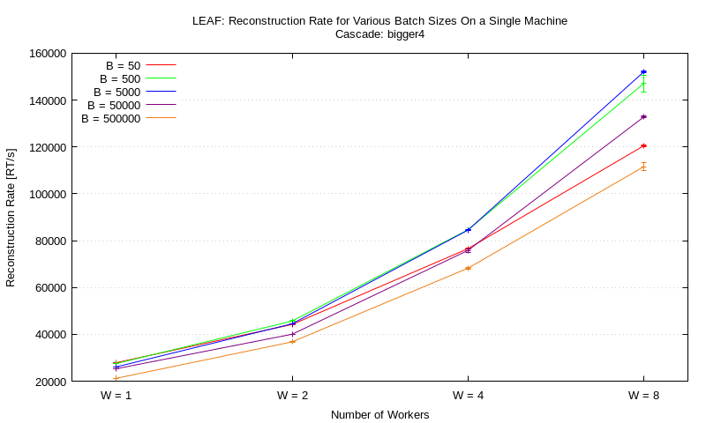
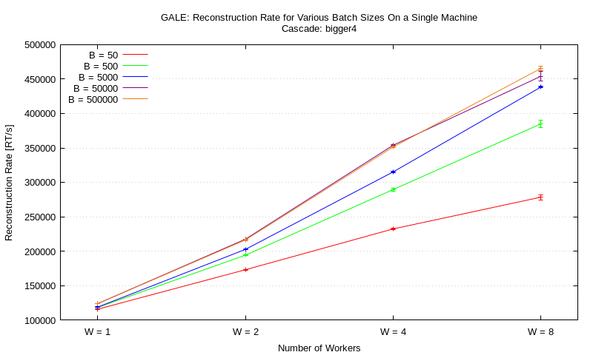
Large Batches
LEAF
GALE

Slide 30
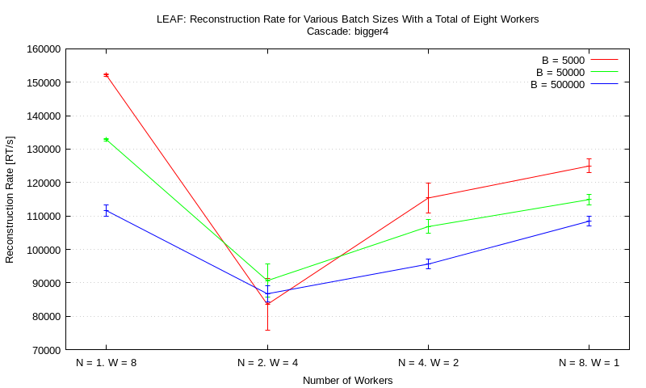
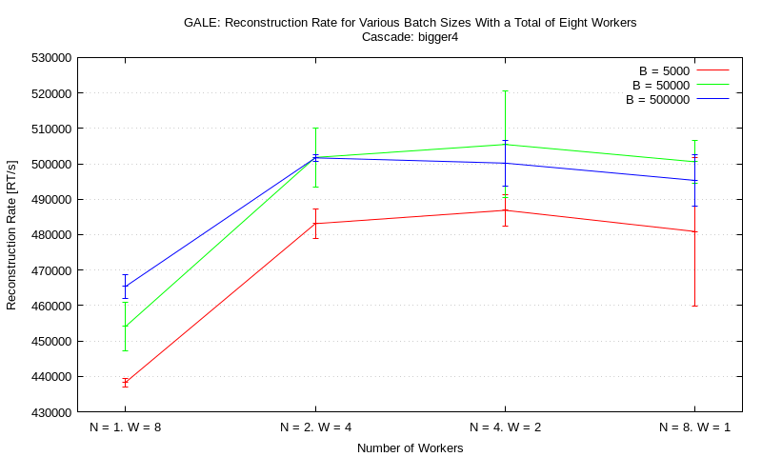
Scaling: Constant Number of Workers
LEAF
GALE

Slide 31
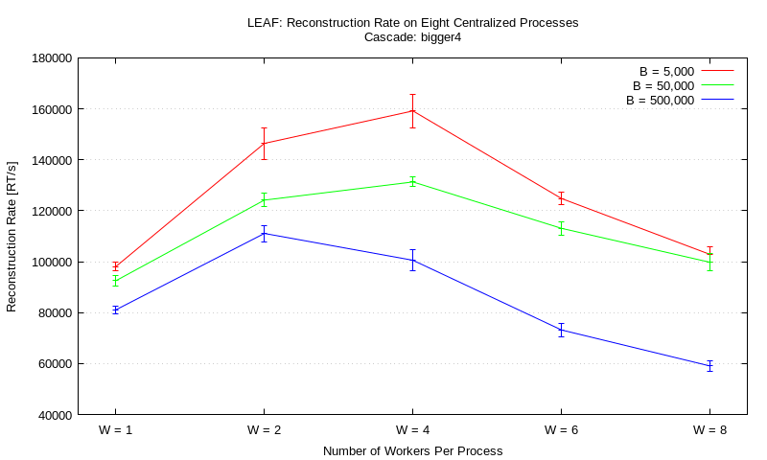
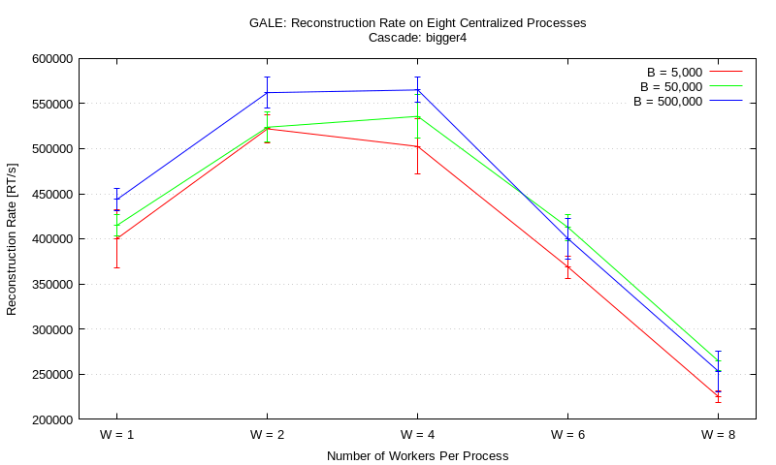
Scaling: Constant Number of Processes Single Machine
LEAF
GALE

Slide 32
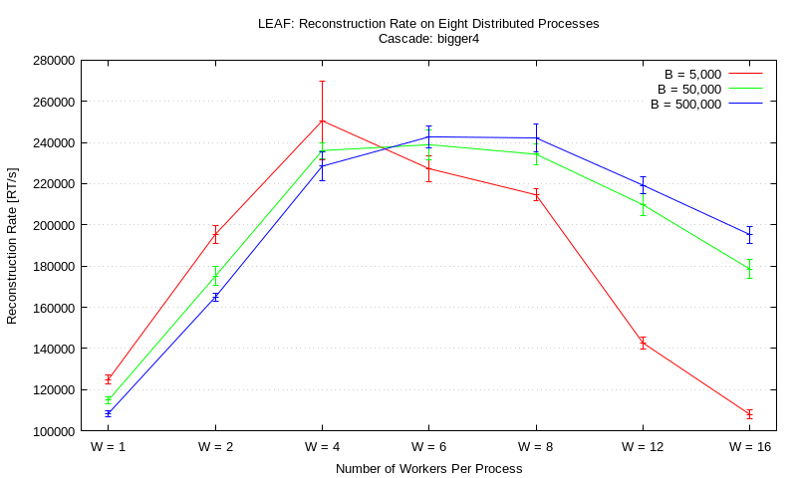
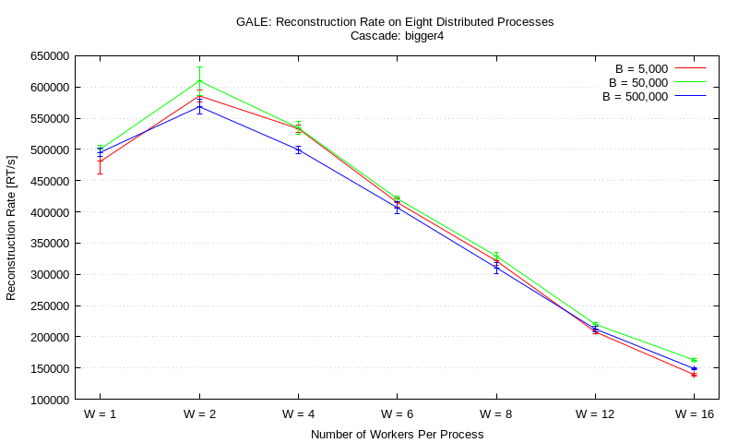
Scaling: Constant Number of Processes Multiple Machines
LEAF
GALE

Slide 33
Conclusion

Slide 34
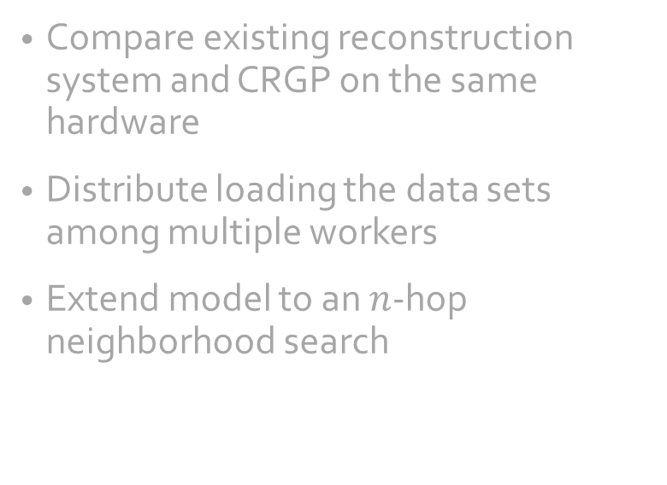
Conclusion
Discussion
Outlook
GALE superior to LEAF
Effect of batch sizes not fully understood
Large batches perform better
50,000 and 500,000 perform similarly
Scaling can occur in two directions: number of workers & number of processes
Reconstruction of 3.6 million Retweets in just over six seconds
Compare existing reconstruction system and CRGP on the same hardware
Distribute loading the data sets among multiple workers
Extend model to an $n$-hop neighborhood search

